Slide 1
An analysis of Digital Steganography for Image Watermarking
Authors
Cosmin Colceru
Toma Nadu
Cristina Andreea Antonescu
Răzvan Adrian Filip

Slide 2
Contents
Subject description (3-4)
Justification for the chosen subject (5)
Technical details (6-9)
Libraries and Packages (10)
Results (11-13)
Conclusions (14)
Bibliography (15)

Slide 3


Subject description
While many of the watermarks we are familiar with are simply layers of pixels which are overlayed onto an image, steganographic techniques make this rather annoying practice invisible to the naked eye.
1
2
Generally speaking, steganography is the practice of hiding information within other information or physical objects. Unlike cryptography, its purpose isn't making the content of the information indecipherable, but hiding its presence altogether. These secret messages usually seem to be part of something else, such as images, articles, or other covert texts^{1,2}.
Even though cryptography and steganography are separate disciplines, they are sometimes combined into robust security schemes. For example, while steganography in itself lacks the need for a secret key, the secret messages can be encrypted before being embedded¹.
Various steganographic techniques have existed since Ancient Greece¹, but modern approaches are centred around digital mediums, the most popular of which are documents, images, videos and audio, because of their large file size.

Slide 4


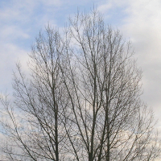
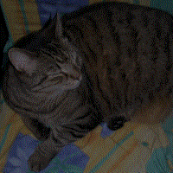
Fortunately or not, the advent of steganography has inspired the development of steganalysis, its twin field of study. The success rate of steganalysis methods varies, but no steganographic techniques are undetectable, when put under serious scrutiny⁷.
Given that steganography stems to make the hidden information as imperceivable as possible, the embedded messages can naturally be used to tag the covert media. As such, image watermarking becomes a valid use case for digital steganographic techniques.
3
4
The two main categories of techniques used on digital images can be separated based on the domain in which information is hidden:
Spatial Domain techniques
Frequency Domain techniques
The result is nonetheless imperceivable at first glance.
3
3
Image of a cat hidden within an image of a tree

Slide 5
Justification for the chosen subject
Steganography, as a force of good, can be indispensable in certain situations:
Tracking of illegal use of copyrighted material. Let's say you're an online magazine which employs dozens of photographers. Before publishing an article, there is some risk for original photos to get leaked. To prevent this, you can create digital signatures which certify the ownership of each photo, as well as the identity of people authorised to access said photo. Using a steganographic technique, these signatures are embedded into every photo taken by every photographer. If a photograph gets leaked, the magazine can not only prove ownership, but it can also pinpoint the precise source of the leakage (the employee who is guilty).
Avoiding censorship. A lot of territories around the world have strict laws against free speech³, and some even ban encryption altogether. Using steganography, citizens are able to communicate without the restrains enforced by authoritarian regimes.
Storage of classified information by law enforcement². When national security is at stake, hiding certain information can be of utmost importance against a common threat.
At the same time, steganalysis is extremely important in detecting unlawful use of steganographic techniques, of which there are many:
As a vector of attack. The arbitrary information hidden within files can very well be malicious payloads, which are then extracted on the target host². Multiple CVEs are based on this simple principle⁴.
Distribution of illicit content. Anything from illegal pornographic imagery to detailed instructions on drug manufacturing².
Espionage. Extracting valuable confidential knowledge about a company or state¹.
As such, studying both disciplines is important for a lot of applications, not only for image watermarking. Also, they're simply fascinating, so they can be intrinsically worthwhile to explore.

Slide 6
Technical details
Spatial domain techniques - Least Significant Bit (LSB)
Frequency domain techniques - JSTEG

Slide 7
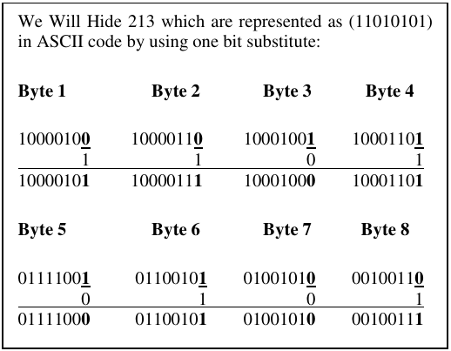
Least Significant Bit (LSB)
LSB is common technique in the insertion and the extraction of the secret information. The LSB method is based on substituting the least significant bits in the color channels of the pixel with the bits of the secret message.
Since the LSBs have the least impact on the overall appearance or quality of the image, this method is a relatively subtle way of embedding information and the change is generally not visible to the human eye.
LSB is effective in BMP images because the uncompressed nature of the BMP format ensures that the message can be embedded without loss, and it is also applicable to PNG images due to their lossless compression, which guarantees accurate preservation of the hidden message.
5

Slide 8
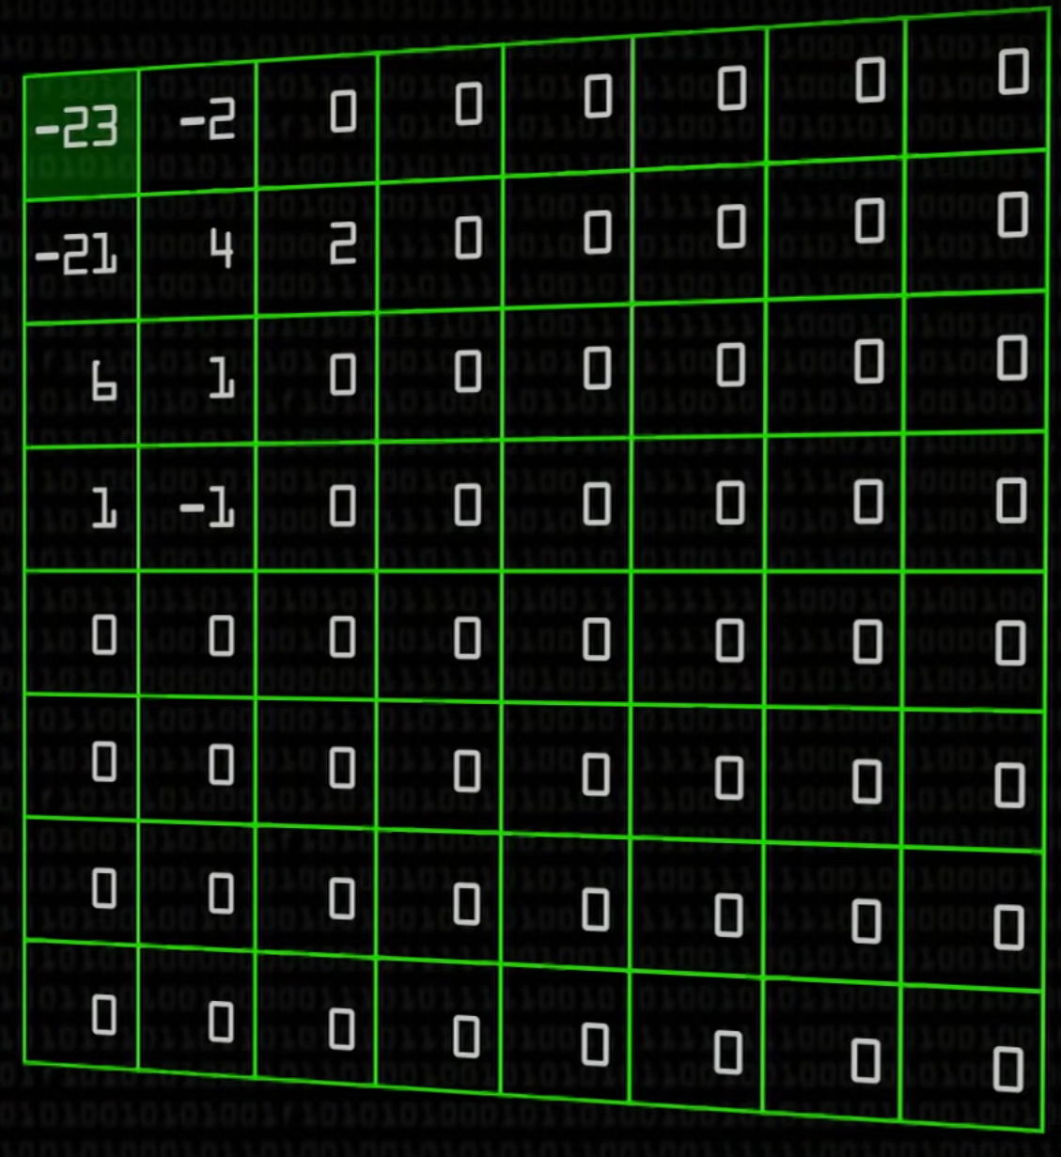
JSTEG
Images can be interpreted as bidimensional signals, which means we can use techniques such as the Discrete Fourier Transform, in order to obtain their representation in the frequency domain. JPEG is the best candidate for a covert image format type, as it is widely used, therefore it attracts less attention.
In the case of the JPEG format, the Discrete Cosine Transform is used for the representation in the frequency domain. The resulting 8x8 blocks contain information about the lower frequency pairs in the top left corner, which are more likely to occur in real images, and which are more noticeable by human perception (the basic principles which JPEG takes advantage of). This is why any change in the coefficients located in that particular spot are more likely to be caught by the human eye, which means that altering values in that region should be avoided. JPEG takes advantage of this by quantizing the rest of the blocks, so that a lot of coefficients are reduced to 0 (which can be compressed to a great degree later).
Even though most of the coefficients in regions of the block other than the top left corner are null, greater values do occur. That is where the desired information can be hidden. Just as it were the case in the spatial domain, we can modify the LSB of these coefficients to the bits of a specific piece of data. To avoid altering the 0s, which would be quite noticeable, both 1s and 0s will remain unchanged (flipping the LSB in a 1 results in a 0, and vice versa). When encoding occurs, the resulting image will be almost undistinguishable.
6
2 = 0b00000010
-1 = 0b11111111
Appropriate coefficients: 2, -1
Hidden data: 0b10...
New coefficients: 3, -2
1 = 0b00000001
(|)
-2 = 0b11111110
(&)
3 = 0b00000011
-2 = 0b11111110

Slide 9
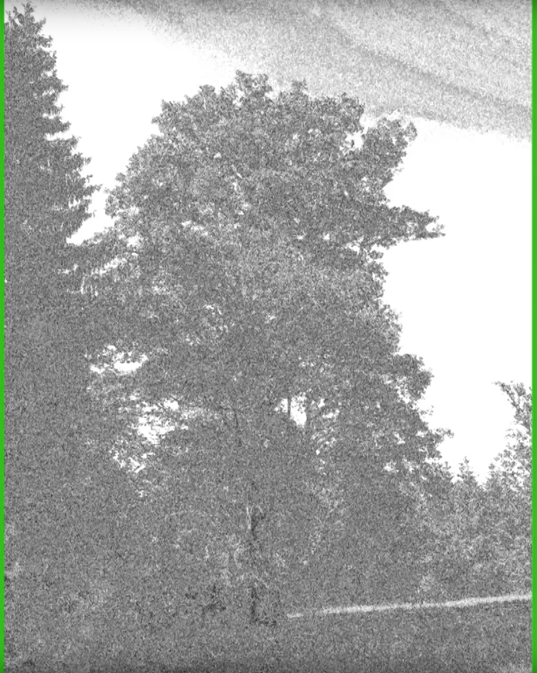
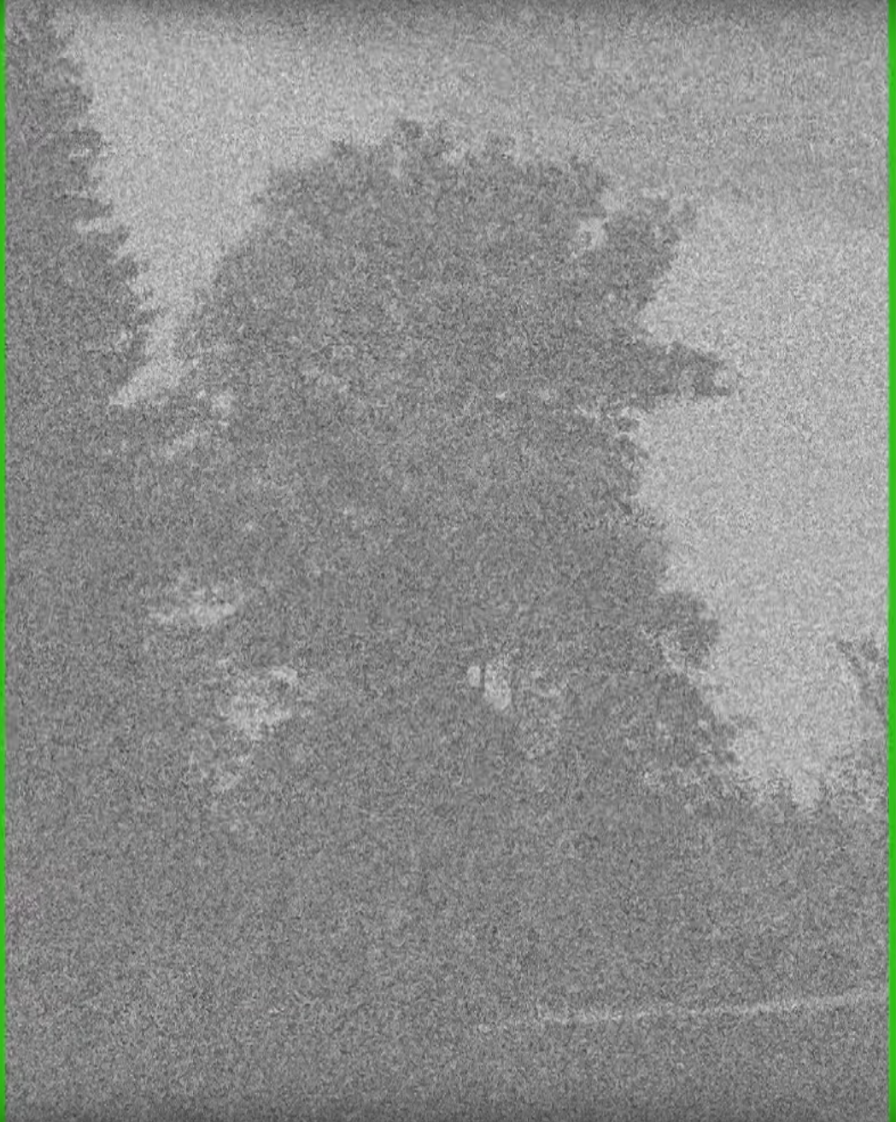
Detection
The simplest method to detect steganography in files is to compare them to known originals, but this is not always possible.
Steganalysis often relies on statistical analysis to detect patterns or deviations from expected statistical properties⁷. For example, changes in the distribution of pixel values, frequency domain analysis, or other statistical measures can be indicative of hidden information. Other approaches include visual attacks, structural attacks, file format analysis and metadata examination.
Machine learning models can be trained to recognize patterns indicative of steganography. These may include supervised learning models that learn from labeled datasets containing both normal and steganographic content.
The visual attack is the most basic steganalysis technique there is. In unmodified images, the last bit of the values of the color channels in each pixel usually preserve the overall structure of the image. We can isolate the last bit or two in each color channel (by filling the rest of the bits with 0s) and visually inspect the result. If it seems to be completely random noise, it is most likely a sign that LSB has been used, and we are viewing the embedded message. If only the first portion of the image appears to contain random noise, while the rest preserves the structure of the image, it is certain that the there is steganographic content within the image.
6
6
Unaltered
Steganographic content

Slide 10
Libraries and Packages
OpenCV (https://pypi.org/project/opencv-python/) – reading and writing PNG files
jpeglib (https://pypi.org/project/jpeglib/) – lots of libraries allow reading JPEG images; the problem is that almost all of them do so by decoding the file back to pixel values; this means that the IDCT is applied, which introduces precision errors; if we were to apply DCT on the decoded pixels, embed the steganographic content, and apply IDCT do obtain the new pixel values, it is very likely that the bits we inserted would change ever so slightly; finally, applying DCT again, to write the image to disk would introduce yet another step where precision errors might occur; and that's before taking into account that different implementations of DCT and IDCT may produce different results; even on very similar systems (same hardware, same OS, same JPEG libraries), there is a chance that decoded pixel values will be different; that's why we only needed a package which would simply decode the Huffman code, and place the DCT blocks into a numpy array
bitarray (https://pypi.org/project/bitarray/) – manipulation of data at the bit level, not the byte level (which python supports); useful when embedding and when extracting data, as each bit, or couple of bits have to be used individually
piexif (https://pypi.org/project/piexif/) – hiding various parameters (size of embedded data, perceptibility value) into EXIF metadata, for subsequent extraction

Slide 11
Results
We expect both LSB and DCT related techniques to be resilient to reasonable amounts of cropping. One potential issue when embedding a plaintext watermark in an image is that an adversary who knows the precise method of embedding can forge the watermark to their own liking. An example of such a watermark might be:
"This is the property of John Smith. This specific copy was given only to Alice and Bob."
Of course, given the method of embedding, one can then simply modify this watermark to:
"This is the property of Alice. This specific copy was given only to Bob."
Using some encryption scheme can alleviate this problem. Encrypted embedded data is good practice, regardless of its nature.
For detection purposes, we will both implement our own techniques, and use open-source tools, such as:
stegoVeritas (works on both JPEGs and PNGs)
zsteg (works on PNGs)
stegdetect (works on JPEGs)
stegbreak (works on JPEGs)

Slide 12
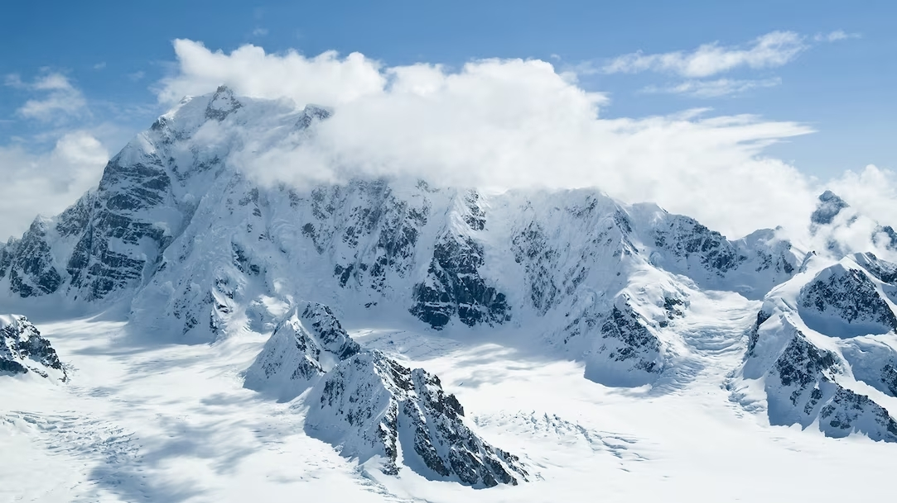
JSTEG
We were unsure about how to decide on the actual boundary between the top left corner and the rest of each DCT block, so we came up with a perceptibility parameter, based on which a moving diagonal line becomes the boundary.
Using our custom implementation, we computed the total storage capacity of a sample image, depending on the perceptibility parameter.
7
1 | 2 | 3 | 4 | 5 | 6 | 7 | 8
18491B | 23404B | 28273B | 32929B | 37318B | 41076B | 44135B | 46105B

Slide 13

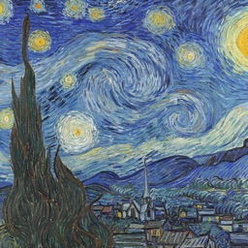
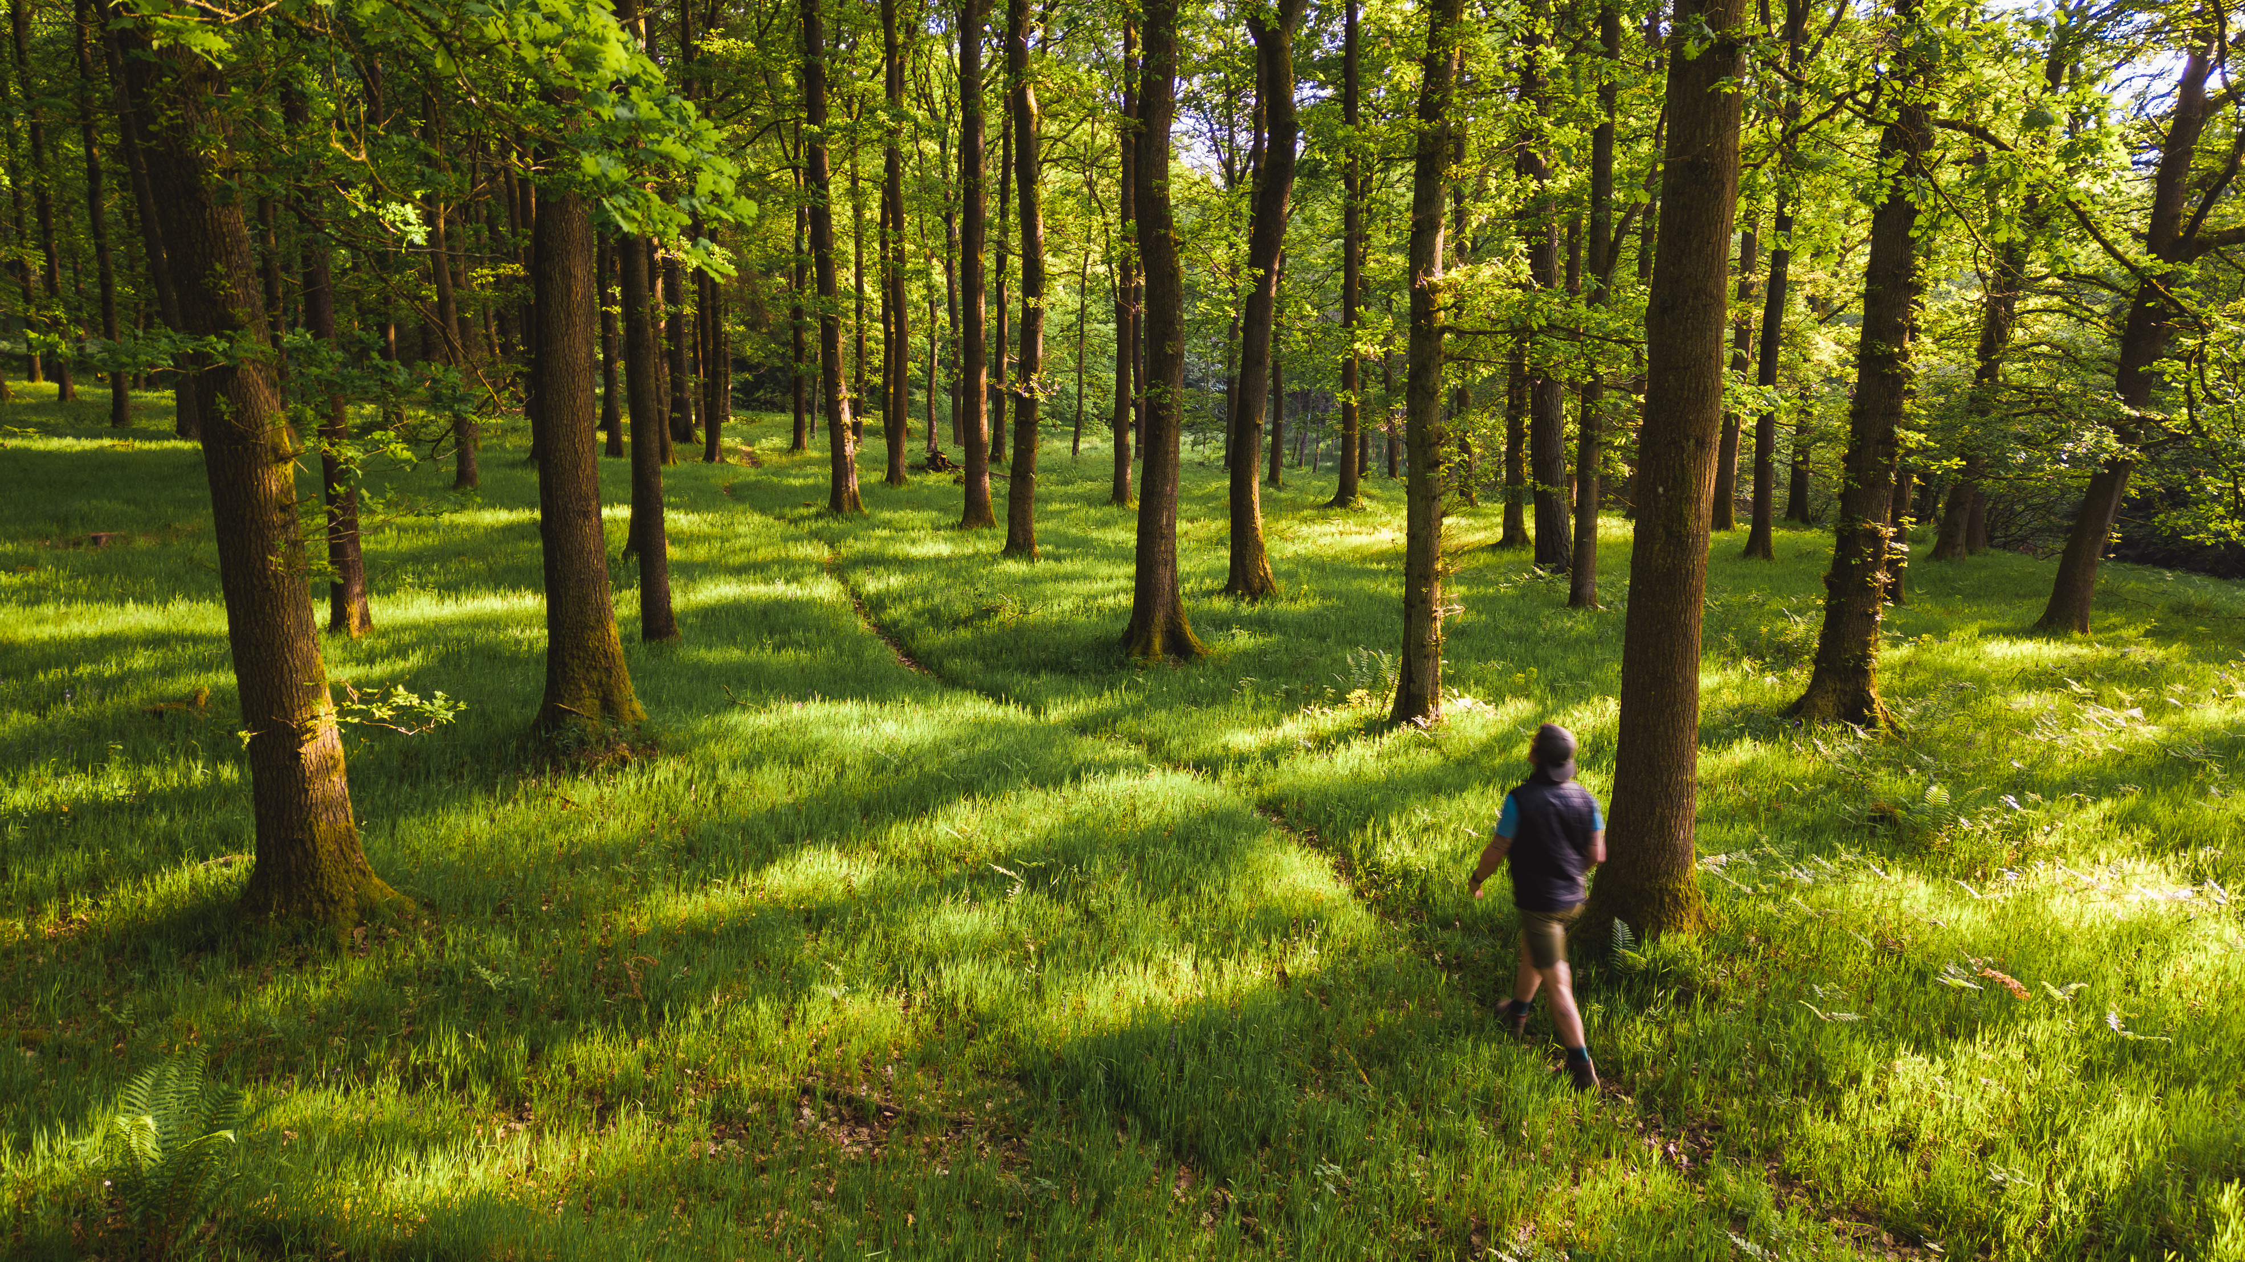
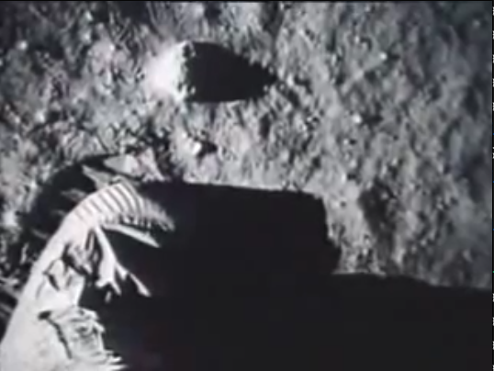
We also had some fun embedding various pieces of data into a few images.
starry-night.jpg
8
moon-landing.mp4
This is the property of John Smith. This specific copy was given only to Alice and Bob.
watermark.txt

Slide 14
Conclusions
Steganography is a valuable practice for lots of use cases, when used as a force for good.
We were able to use as much as 1/4 of an image size to hide arbitrary data, at the expense of increased perceptibility, and as much as X for maximum protection against steganalysis techniques.
We suspect that it is much harder to assess the steganographic character of an image, when storage size is sacrificed, and custom embedding schemes are employed, even with basic spatial domain techniques (LSB).
The utilization of steganography for image watermarking can aid in the protection of intellectual property by embedding imperceptible information within images. This process enables content owners to assert ownership without significantly degrading the visual quality of the image.
By encrypting the watermarks, we can ensure their integrity, even though their removal is still possible.
Without specific information about images, the detection of steganographic content is a complex mathematical task, due to the sheer variability in the statistical properties of natural, unaltered images, making it challenging to assess with any degree of certainty whether content has been embedded within an image, and even harder to differentiate between legitimate applications like image watermarking and potentially malicious use cases.

Slide 15
Bibliography
Information:
https://en.wikipedia.org/wiki/Steganography (Steganography - Wikipedia)
https://www.kaspersky.com/resource-center/definitions/what-is-steganography (What is steganography? Definition and explaination - Kaspersky)
https://cve.mitre.org/cgi-bin/cvekey.cgi?keyword=steganography (CVE MITRE Search Engine)
https://en.wikipedia.org/wiki/Cryptography_law (Cryptography law - Wikipedia)
https://www.youtube.com/watch?v=TWEXCYQKyDc (Secrets Hidden in Images (Steganography) - Computerphile)
https://www.cs.unc.edu/~lin/COMP089H/LEC/steganography.pdf (Steganography: Hiding Data In Plain Sight – Ryan Gibson)
https://www.youtube.com/watch?v=BQPkRlbVFEs (Advanced JPEG Steganography and Detection – John Ortiz)
Images:
https://www.lukecollinsphotography.com/should-you-watermark-images/ (Should you watermark your images? Yes! Within reason. - Luke Collins)
https://fooplugins.com/should-you-watermark-images/ (Should You Watermark Images In Your WordPress Gallery? - FooPlugins)
https://en.wikipedia.org/wiki/Steganography (Steganography - Wikipedia)
https://www.wired.com/story/steganography-hacker-lexicon/ (Hacker Lexicon: What Is Steganography? - Lily Hay Newman)
https://research.ijcaonline.org/volume99/number5/pxc3897896.pdf (Image Steganography using LSB and LSB+Huffman Code - Wa'el Ibrahim A. Al-Mazaydeh)
https://www.youtube.com/watch?v=TWEXCYQKyDc (Secrets Hidden in Images (Steganography) - Computerphile)
https://kids.nationalgeographic.com/nature/habitats/article/mountain (Mountain Habitat – Avery Hurt)
https://www.forestryengland.uk/mortimer-forest

